Slide 1

Brute-forcing a web login
By Nechemia Renzoni and Ariel Shumacher

Slide 2
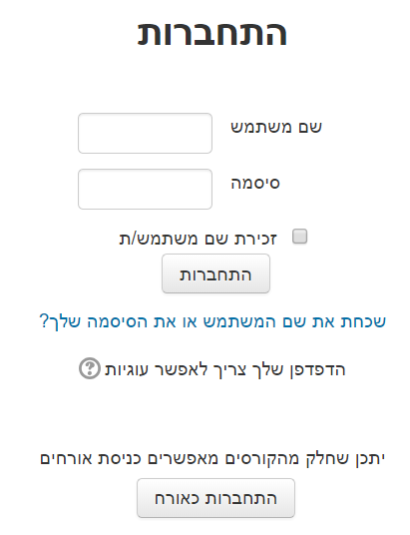

Goal: discover password for given user on website
stulman
???

Slide 3



us
them

Slide 4
Naive crack method
write a script which uses a common password wordlist and brute forces the password
Problem: fail2Ban – python script on server that scans apache log and blocks an IP if makes multiple requests in a short time-span from same IP

Slide 5


Slide 6

Writing web-login cracking script: what does a successful login look like?
Failed login contains keyword, such as: “bad login”, whereas successful login doesn’t
HTTP Redirect. response code: 302 found.
Response content has different size for failed / successful login

Slide 7
Getting around fail2ban: Solution 1 (hacky)
Some servers use the ‘X-Forwarded-For’ HTTP header to extract real IP behind forward-proxy.
Trick: set ‘X-Forwarded-For’ to random valid IP (a, b, c) for each request; brute-force password from one attacker host; victim server believes random IPs (a, b, c) are real IPs of connection and therefore fail to detect attack.
*wiki-link

Slide 8
X-Forwarded-For spoof against IP lookup service api.ipify.org
from requests import get response = get(url='http://api.ipify.org', headers={'X-Forwarded-For': '192.168.1.1'}) print('detected source ip: {}'.format(response.text))
Results:
detected source IP: 192.168.1.1

Slide 9

Server side defensive solution
Log both IP layer IP address and ‘X-Forwarded-For’ IP address
For each new client login attempt, check against any previously logged IPs

Slide 10

Getting around fail2ban: Solution 2!
Use distributed forward-proxies.
Each proxy has different IP.
After trying password through one proxy, move on to using another proxy with different password.

Slide 11




Slide 12
Distributed forward-proxies Problem: Where to find distributed proxies?
Many open un-authenticated web proxies available
Solution 1:
Scrape websites listing open proxies
http://www.cool-proxy.net/proxies/http_proxy_list
http://free-proxy-list.net/
http://gatherproxy.com/
… and many others
Solution 2:
Write an automated web-scanner looking for open web-proxies

Slide 13
Two Primary forward-proxy protocols: HTTP-Forwarding and SOCKS
HTTP-Forwarding proxy
HTTP request headers sent to proxy server:
GET http://moodle.jct.ac.il/login HTTP/1.1
Host: moodle.jct.ac.il
Proxy-Connection: Keep-Alive
HTTPS request headers sent to proxy server
CONNECT moodle.jct.ac.il:443 HTTP/1.1
Host: moodle.jct.ac.il:443
Proxy-Connection: Keep-Alive
HTTP proxy performs requests on behalf of client
HTTPS proxy forwards TCP connections
required
*connect causes proxy to act as TCP tunnel

Slide 14
Problem with HTTP proxy: Not all public proxies are anonymous (and we don’t want victim to know who’s attacking)
At discretion of HTTP forward-proxy, can include ‘X-Forwarded-For’ HTTP header or similar header, leaking attacker’s IP.
Solution:
Check if the proxy leaks attacker’s IP against service like api.ipify.org before using the proxy.

Slide 15
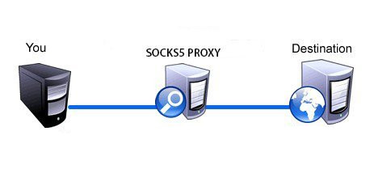

SOCKS4/SOCKS5 proxy
Creates tunnel from client to destination.
Original HTTP request forwarded to destination.
HTTP headers not changed = no ‘X-Forwarded-For’ header appended.

Slide 16

Automating The Attack
Implementation details:
What to do if a proxy server is dead?
How many passwords to try on each proxy before moving on to next proxy?
Which proxy protocols to support?
Detect failed / successful login?

Slide 17

Server- side defenses
Captcha
Slow down response for multiple login attempts to single account
Lock account temporarily (DOS attack possible)
Make response for successful / failed login similar
Same content size
Failed login keyword returned in successful login also
== Makes attacker’s job difficult

Slide 18
DDDEMO TIMMMEEEEEE!!!

